Slide 1
Application of multivariate classification to
classify vehicle silhouettes
Manasa PRAKASH
Jean GUILLAME

Slide 2
Index
Classification in Machine Learning Multivariate Classification Data Scrapping Data preparation | Data visualisation Data Modelisation Hyperparameter Optimisation Performance Tuning

Slide 3
Classification in Machine Learning
Linear classifiers
Fisher's linear discriminant
Logistic regression
Naive Bayes classifier
Perceptron
Support vector machines
Least squares support vector machines
Quadratic classifiers
Kernel estimation
k-nearest neighbor
Decision trees
Random forests
Neural networks
Learning vector quantization
Classification is the problem of identifying to which of a set of categories (sub-populations) a new observation belongs, on the basis of a training set of data containing observations (or instances) whose category membership is known.
The most commonly used classification algorithms are listed on the side.

Slide 4
Multivariate Classification
In machine learning, multiclass or multinomial classification is the problem of classifying instances into one of three or more classes. (Classifying instances into one of the two classes is called binary classification.)
The existing multi-class classification techniques can be categorized into (i) Transformation to binary (ii) Extension from binary and (iii) Hierarchical classification.
This is done using two strategies : (i) One vs Rest (ii) One vs One
Multi-label classification is a generalization of multiclass classification, which is the single-label problem of categorizing instances into precisely one of more than two classes; in the multi-label problem there is no constraint on how many of the classes the instance can be assigned to.

Slide 5
Data Scrapping
The data has been collected from the UCI’s online data repository for ML problems.
The scrapping was done through a python code developed for the purpose of this project.
The scrapper is able to download ANY dataset from the repository, and is not limited to the dataset relevant to this project!
The scrapper works in three steps:
Collects list of available datasets from the website.
Gets user input on which dataset is to be downloaded.
Returns all downloadable files from the chosen collection and downloads to the current working directory.

Slide 6
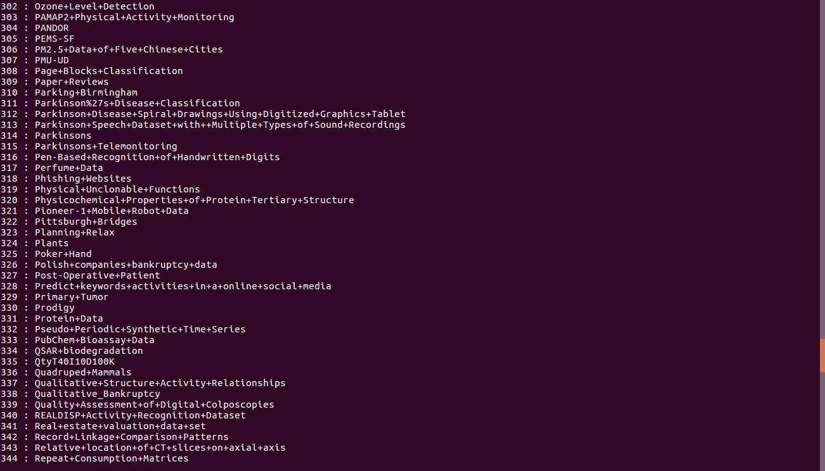
Scrapper List

Slide 7
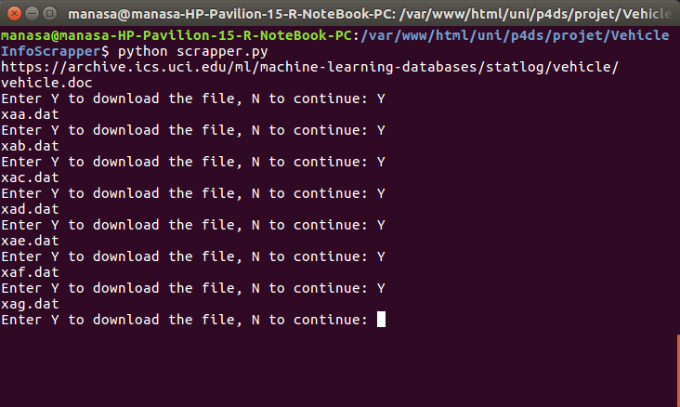
List of downloadable files

Slide 8
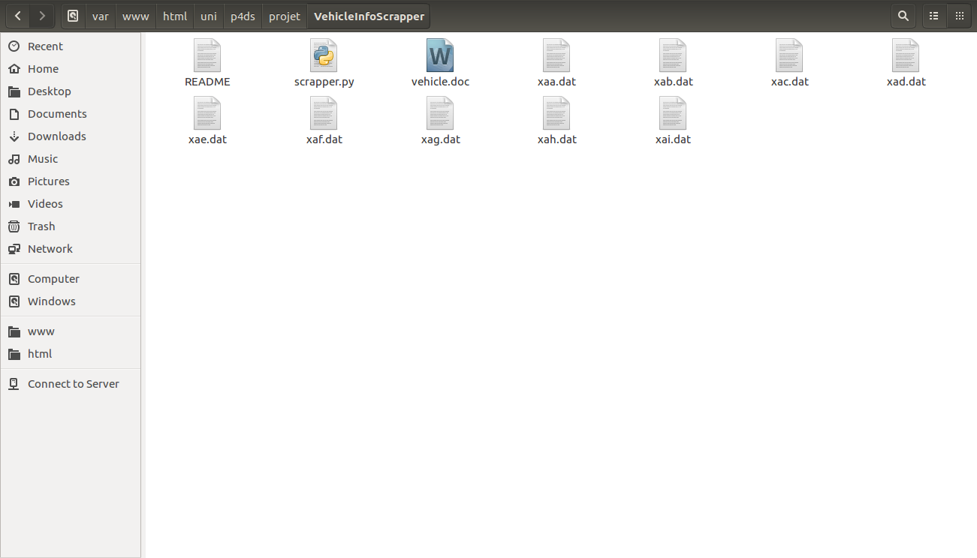
Files downloaded

Slide 9
The purpose is to classify a given silhouette as one of four types of vehicle, using a set of features extracted from the silhouette.
The vehicle may be viewed from one of many different angles. The features were extracted from the silhouettes by the HIPS (Hierarchical Image Processing System) extension BINATTS, which extracts a combination of scale independent features utilising both classical moments based measures such as scaled variance, skewness and kurtosis about the major/minor axes and heuristic measures such as hollows, circularity, rectangularity and compactness.
Four "Corgie" model vehicles were used for the experiment: a double decker bus, Cheverolet van, Saab 9000 and an Opel Manta 400. This particular combination of vehicles was chosen with the expectation that the bus, van and either one of the cars would be readily distinguishable, but it would be more difficult to distinguish between the cars.
There are around 850 data points.

Slide 10
The 19 associated variables are:
COMPACTNESS | INT
CIRCULARITY | INT
DISTANCE CIRCULARITY | INT
RADIUS RATIO | INT
AXIS ASPECT RATIO | INT
MAX LENGTH ASPECT RATIO | INT
SCATTER RATIO | INT
ELONGATEDNESS | INT
AXIS RECTANGULARITY | INT
MAX.LENGTH RECTANGULARITY | INT
SCALED VARIANCE ALONG MAJOR AXIS | INT
SCALED VARIANCE ALONG MINOR AXIS | INT
SCALED RADIUS OF GYRATION | INT
SKEWNESS ABOUT MAJOR AXIS | INT
SKEWNESS ABOUT MINOR AXIS | INT
KURTOSIS ABOUT MINOR AXIS | INT
KURTOSIS ABOUT MAJOR AXIS | INT
HOLLOWS RATIO | INT
CLASS | STR

Slide 11
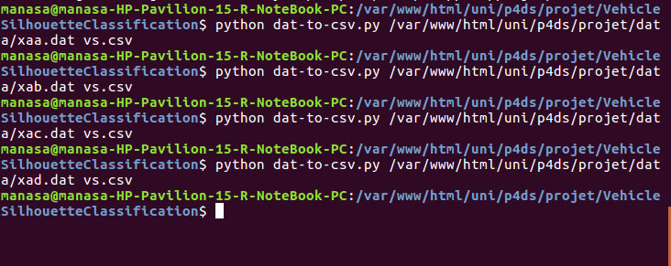
Data preparation
The first step was to convert the dat files to a single csv to make for easier reading. This was done using a small script that took command line arguments with the original and target file name/path.

Slide 12
The preparation is well explained in the Jupyter notebook.
Minor changes such as changing the format to int, numbering the categories instead of using them as float are made.
Notes:
Plan :

Slide 13
Data visualisation
We are visualising the distribution of the categories.

Slide 14
Data Modelisation
The data is initially split into 50-50, 70-30 and 80-20 train and test sets. The 70-30 split seems to work the best.
The model used is th SGD Classifier with the idea of improving it’s performance in the next steps.
SGD Classifier implements regularised linear models with Stochastic Gradient Descent. Stochastic gradient descent considers only 1 random point while changing weights unlike gradient descent which considers the whole training data. As such stochastic gradient descent is much faster than gradient descent when dealing with large data sets

Slide 15
Hyperparameter Optimisation
We are using Logistic Regression with ‘l2’ penalty as our benchmark here. For Logistic Regression, we will be tuning 1 hyper-parameter, C.
C = 1/λ, where λ is the regularisation parameter.
Smaller values of C specify stronger regularisation. Since parfit fits the model in parallel, we can give a wide range of parameters for C.

Slide 16
Performance
Checked using false positive, false negative ROC graphs.

Slide 17
Conclusion
Different ways of using Python to solve data science problems were explored in the class with unique and interactive sessions with Mr. Jouin.
This project tries to work on improving the performance of SGD Classifiers.

